Slide 1
Contents
Today's Topic: Introduction to Operating Systems
We will learn
      What is Operating System?
      What OS does?
      Structure of OS
      Evolution of OS
        Batch Processing, Multiprogramming, Time sharing systems
      Operating System Functions
      Main Functions of OS
      Types of OS
        Single User, Multi User systems

Slide 2
Operating Systems

Slide 3
What is OS?
Operating System is a software, which makes a computer to actually work.
It is the software that enables all the programs we use.
The OS organizes and controls the hardware.
OS acts as an interface between the application programs and the machine hardware.
Examples: Windows, Linux, Unix and Mac OS, etc.,

Slide 4
Operating System Definitions
Resource allocator – manages and allocates resources.
Control program – controls the execution of user programs and operations of I/O devices .
Kernel – the one program running at all times (all else being application programs).
Operating System Concepts

Slide 5
What OS does?
An operating system performs basic tasks such as,
    controlling and allocating memory,
    prioritizing system requests,
    controlling input and output devices,
    facilitating networking and
    managing file systems.

Slide 6
Components of Operating System
Application Programs
System Programs
Software (Operating System)
HARDWARE

Slide 7
Components of Operating System
The structure of OS consists of 4 layers:
        Hardware
        The hardware—the central processing unit (CPU), the memory, and the input/output (I/O) devices—provides the basic computing resources for the system.
        Software (Operating System)
        The operating system controls and coordinates the use of the hardware among the various application programs for the various users.

Slide 8
Components of Operating System
        System programs
        This layer consists of compilers, Assemblers, linker etc.
        Application programs
        The application programs—such as word processors, spreadsheets, compilers, and web browsers—define the ways in which these resources are used to solve users' computing problems.

Slide 9
We can also view a computer system as consisting of hardware, software, and data.
The operating system provides the means for proper use of these resources in the operation of the computer system.
An operating system is similar to a government. Like a government, it performs no useful function by itself. It simply provides an environment within which other programs can do useful work.

Slide 10

Abstract View of System Components
Operating System Concepts

Slide 11
Basic Terminologies used
Kernel
Shell
System Calls

Slide 12
Viewpoints of OS
USER VIEW:
The user's view of the computer varies according to the interface being
used.
Most computer users sit in front of a PC, consisting of a monitor, keyboard, mouse, and system unit. Such a system is designed for one user to monopolize its resources.
The goal is to maximize the work (or play)that the user is performing.
In this case, the operating system is designed mostly for ease of use, with some attention paid to performance and none paid to resource utilization— how various hardware and software resources are shared.
Performance is, of course, important to the user; but rather than resource utilization, such systems are optimized for the single-user experience.

Slide 13
In other cases, a user sits at a terminal connected to a mainframe or minicomputer. Other users are accessing the same computer through other terminals. These users share resources and may exchange information.
The operating system in such cases is designed to maximize resource utilization— to assure that all available CPU time, memory, and I/O are used efficiently and that no individual user takes more than her fair share.
In still other cases, users sit at workstations connected to networks of other workstations and servers. These users have dedicated resources at their disposal, but they also share resources such as networking and servers—file, compute, and print servers. Therefore, their operating system is designed to compromise between individual usability and resource utilization.

Slide 14
System View
From the computer's point of view, the operating system is the program
most intimately involved with the hardware.
In this context, we can view an operating system as a resource allocator.
A computer system has many resources that may be required to solve a problem:
CPU time, memory space, file-storage space, I/O devices, and so on.
The operating system acts as the manager of these resources.
A slightly different view of an operating system emphasizes the need to control the various I/O devices and user programs. An operating system is a control program.
A control program manages the execution of user programs to prevent errors
and improper use of the computer. It is especially concerned with the operation and control of I/O devices.

Slide 15
Evolution of OS
The evolution of operating systems went through seven major phases.
Six of them significantly changed the ways in which users accessed computers through the open shop, batch processing, multiprogramming, timesharing, personal computing, and distributed systems.
In the seventh phase the foundations of concurrent programming were developed and demonstrated in model operating systems.
      (Contd…)

Slide 16
Evolution of OS (contd..):
Major Phases | Technical Innovations | Operating Systems
Open Shop | The idea of OS | IBM 701 open shop (1954)
Batch Processing | Tape batching, First-in, first-out scheduling. | BKS system (1961)
Multi- programming | Processor multiplexing, Indivisible operations, Demand paging, Input/output spooling, Priority scheduling, Remote job entry | Atlas supervisor (1961), Exec II system (1966)
(Contd…)

Slide 17
Evolution of OS (contd..):
Timesharing | Simultaneous user interaction, On-line file systems | Multics file system (1965), Unix (1974)
Concurrent Programming | Hierarchical systems, Extensible kernels, Parallel programming concepts, Secure parallel languages | RC 4000 system (1969), 13 Venus system (1972), 14 Boss 2 system (1975).
Personal Computing | Graphic user interfaces | OS 6 (1972) Pilot system (1980)
Distributed Systems | Remote servers | WFS file server (1979) Unix United RPC (1982) 24 Amoeba system (1990)

Slide 18
Open Shop OS
Each user was allocated a block of time to load and run his/her program, which was input from punch cards.
Debugging consisted of inspecting the internal machine states and patching them directly.
Device drivers (device-specific routines), functions, compilers, and assemblers had to be explicitly loaded.

Slide 19
Batch Operating Systems
In Batch Processing Systems, similar types of jobs job (comprising of the program, the data, & some control information) are firstly prepared and they are Stored on the Card and that card will be Submit to the System for the Processing.
The System then Perform all the Operations on the Instructions one by one and a user can’t be able to specify any input.
Operating System wills increments the Program Counter for Executing the Next Instruction.
Operating System will use the LOAD and RUN Operation. This will first LOAD the Job from the Card and after that he will execute the instructions by using the RUN Command.
Common input devices were card readers and tape drives.
Common output devices were line printers, tape drives, and card punches.

Slide 20
Batch Operating Systems
The users of a batch operating system do not interact with the computer directly. Each user prepares his job on an off-line device like punch cards and submits it to the computer operator. To speed up processing, jobs with similar needs are batched together and run as a group. The programmers leave their programs with the operator and the operator then sorts the programs with similar requirements into batches.
The problems with Batch Systems are as follows:
Lack of interaction between the user and the job. If a job requires any type of Input then this will not be Possible for the user.
Time will be wasted for Preparing the Batch.
CPU is often idle, because the speed of the mechanical I/O devices is slower than
the CPU.
Difficult to provide the desired priority.

Slide 21
Batch Processing (Contd…):
OS
User program area

Slide 22
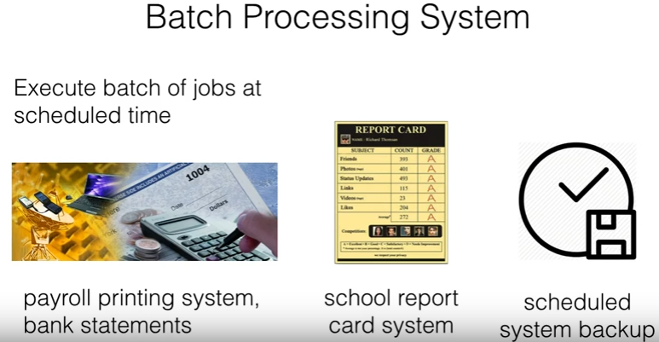

Slide 23
Example
An example of batch processing is the way that credit card companies process billing. The customer does not receive a bill for each separate credit card purchase but one monthly bill for all of that month’s purchases. The bill is created through batch processing, where all of the data are collected and held until the bill is processed as a batch at the end of the billing cycle.
In banking industry, batches of deposited checks are accumulated and processed on a daily basis.

Slide 24
Multiprogramming:
Multiprogramming is a technique to execute number of programs simultaneously by a single processor.
In Multiprogramming, number of processes reside in main memory at a time.
The OS picks and begins to executes one of the jobs in the main memory.
If any I/O wait happened in a process, then CPU switches from that job to another job.
Hence CPU in not idle at any time.

Slide 25
Multiprogramming (Contd…):
OS
Job 1
Job 2
Job 3
Job 4
Job 5
Figure dipicts the layout of multiprogramming system.
The main memory consists of 5 jobs at a time, the CPU executes one by one.
Advantages:
Efficient memory utilization
Throughput increases
CPU is never idle, so performance increases.

Slide 26
Time Sharing Systems:
A time sharing system allows the many users to simultaneously share the computer resources at the same time.
Time sharing, or multitasking, is a logical extension of multiprogramming. Processor's time which is shared among multiple users simultaneously is termed as time-sharing.
Multiple jobs are executed by switching the CPU between them.
In this, the CPU time is shared by different processes, so it is called as “Time sharing Systems”.
Time slice is defined by the OS, for sharing CPU time between processes.
Examples: Multics, Unix, etc.,

Slide 27
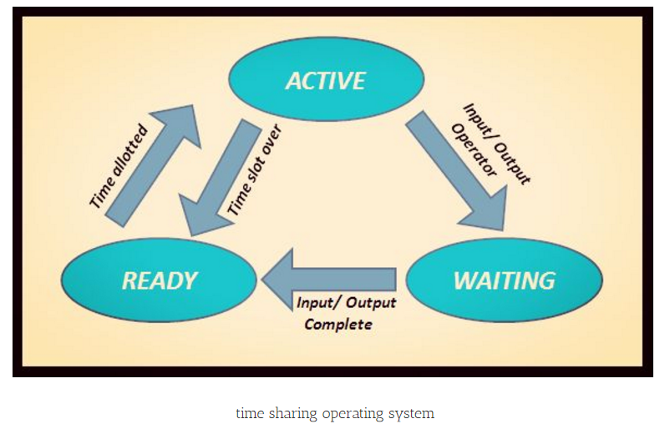

Slide 28
The main difference between Multiprogrammed Batch Systems and Time-Sharing Systems is that in case of Multiprogrammed batch systems, the objective is to maximize processor use, whereas in Time-Sharing Systems, the objective is to minimize response time.
Multiple jobs are executed by the CPU by switching between them, but the switches occur so frequently. Thus, the user can receive an immediate response.
For example, in a transaction processing, the processor executes each user program in a short burst or quantum of computation. That is, if n users are present, then each user can get a time quantum. When the user submits the command, the response time is in few seconds at most.

Slide 29
Advantages of Timesharing operating systems are as follows:
Provides the advantage of quick response
Avoids duplication of software
Reduces CPU idle time

Slide 30
Disadvantages of Time-sharing operating systems are as follows:
Problem of reliability
Question of security and integrity of user programs and data
Problem of data communication

Slide 31
Example
Bank’s bankcard system, which allows hundreds of people to access the same program on the mainframe at the same time.
Watching a movie while downloading a song

Slide 32
Concurrent Programming
In concurrent programming, complex problem are broken into several simultaneous executing processes that can be addressed individually.

Slide 33
Distributed Systems
Distributed Means Data is Stored on to the Multiple Computers which are placed in Different Locations. Then if we want to Take Some Data From other Computer then we use the Distributed Processing System.

Slide 34
Distributed Systems
Distributed systems use multiple central processors to serve multiple real-time applications and multiple users. Data processing jobs are distributed among the processors accordingly.
The processors communicate with one another through various communication lines (such as high-speed buses or telephone lines). These are referred as loosely coupled systems or distributed systems.
Processors in a distributed system may vary in size and function.
These processors are referred as sites, nodes, computers, and so on.

Slide 35
Distributed Systems
Distribute the computation among several physical processors.
Loosely coupled system – each processor has its own local memory; processors communicate with one another through various communications lines, such as high-speed buses or telephone lines.
Advantages of distributed systems.
  Resources Sharing
  Computation speed up – load sharing
  Reliability
  Communications
Operating System Concepts

Slide 36
Distributed Systems (cont)
Requires networking infrastructure.
Local area networks (LAN) or Wide area networks (WAN)
May be either client-server or peer-to-peer systems.
Operating System Concepts

Slide 37
The advantages of distributed systems are as follows:
With resource sharing facility, a user at one site may be able to use the resources available at another.
Speedup the exchange of data with one another via electronic mail.
If one site fails in a distributed system, the remaining sites can potentially continue operating.
Better service to the customers.
Reduction of the load on the host computer.
Reduction of delays in data processing.

Slide 38
Desktop Systems
Personal computers – computer system dedicated to a single user.
I/O devices – keyboards, mice, display screens, small printers.
User convenience and responsiveness.
Can adopt technology developed for larger operating system’ often individuals have sole use of computer and do not need advanced CPU utilization of protection features.
May run several different types of operating systems (Windows, MacOS, UNIX, Linux)
Operating System Concepts

Slide 39
Parallel Systems
Multiprocessor systems with more than one CPU in close communication.
Tightly coupled system – processors share memory and a clock; communication usually takes place through the shared memory.
Advantages of parallel system:
  Increased throughput
  Economical
  Increased reliability
    graceful degradation
    fail-soft systems
Operating System Concepts

Slide 40
Parallel Systems (Cont.)
Symmetric multiprocessing (SMP)
  Each processor runs and identical copy of the operating system.
  Many processes can run at once without performance deterioration.
  Most modern operating systems support SMP
Asymmetric multiprocessing
  Each processor is assigned a specific task; master processor schedules and allocated work to slave processors.
  More common in extremely large systems
Operating System Concepts

Slide 41

Symmetric Multiprocessing Architecture
Operating System Concepts

Slide 42

General Structure of Client-Server
Operating System Concepts

Slide 43
Clustered Systems
Clustering allows two or more systems to share storage.
Provides high reliability.
Asymmetric clustering: one server runs the application while other servers standby.
Symmetric clustering: all N hosts are running the application.
Operating System Concepts

Slide 44
Real-Time Systems
A real-time system is defined as a data processing system in which the time interval required to process and respond to inputs is so small that it controls the environment. The time taken by the system to respond to an input and display of required updated information is termed as the response time.
So in this method, the response time is very less as compared to online processing.
Real-time systems are used when there are rigid time requirements on the operation of a processor or the flow of data and real-time systems can be used as a control device in a dedicated application.
A real-time operating system must have well-defined, fixed time constraints, otherwise the system will fail. For example, Scientific experiments, medical imaging systems, industrial control systems, weapon systems, robots, air traffic control systems, etc.
Operating System Concepts

Slide 45
Real Time System is used at those Places in which we Requires higher and Timely Response. These Types of Systems are used in Reservation. So when we specify the Request, the CPU will perform at that Time. There are two Types of Real Time System
1) Hard Real Time System: In the Hard Real Time System, Time is fixed and we can’t Change any Moments of the Time of Processing. Means CPU will Process the data as we Enters the Data.
2) Soft Real Time System: In the Soft Real Time System, some Moments can be Change. Means after giving the Command to the CPU, CPU Performs the Operation after a Microsecond.

Slide 46
Real-Time Systems (Cont.)
Hard real-time systems
Hard real-time systems guarantee that critical tasks complete on time. In hard real-time systems, secondary storage is limited or missing and the data is stored in ROM.
In these systems, virtual memory is almost never found.
Soft real-time systems
Soft real-time systems are less restrictive. A critical real-time task gets priority over other tasks and retains the priority until it completes.
Soft real-time systems have limited utility than hard real-time systems. For example, multimedia, virtual reality, Advanced Scientific Projects like undersea exploration and planetary rovers, etc.
Operating System Concepts

Slide 47
Handheld Systems
Personal Digital Assistants (PDAs)
Cellular telephones
Issues:
  Limited memory
  Slow processors
  Small display screens.
Operating System Concepts

Slide 48
Single user
Single User Systems: Provides a platform for only one user at a time. They are popularly associated with Desk Top operating system which run on standalone systems where no user accounts are required. Example: DOS

Slide 49
Multiple user
Multi-User Systems: Provides regulated access for a number of users by maintaining a database of known users. Refers to computer systems that support two or more simultaneous users. Another term for multi-user is time sharing. Ex: All mainframes and are multi-user systems. Example: Unix

Slide 50

Migration of Operating-System Concepts and Features
Operating System Concepts

Slide 51
Operating Systems functions:
The main functions of operating systems are:
    Program creation
    Program execution
    Input/Output operations
    Error detection
    Resource allocation
    Accounting
    protection

